Slide 1

Einfluss von Unternehmen
Joshua Bernhart & TOM Fimpel

Slide 2
Influence on People
Tom Fimpel

Slide 3
„DAS HERZSTÜCK EINES GUTEN NATIVE ADVERTISING IST EIN KLARES VERSTÄNDNIS DER INTERESSEN IHRER ZIELGRUPPE. WENN SIE SIE KENNEN, IST ES VIEL EINFACHER, DIE RICHTIGEN INHALTE, VERTRIEBSKANÄLE UND FORMATE FÜR EINE GUTE KAMPAGNE ZU DEFINIEREN.“
–Karsten Krämer

Slide 4
The use of media
The average human uses media 10 hours a day
Companies can influence us 10 hours a day with media
Influence trough advertisements/target advertising, influencer…
Ads are everywhere and influence our perception

Slide 5
How advertisements work
Showing us products of companies and make us fell that we need them
Telling us, our life would be more complicated without the product of that companie
We think the product is usefull/necessary -> we buy it
We got influenced through advertisements of big companies
Big companies can spend more money on ads than smaller ones -> they make more profot
It‘s all about manipulation to make more profit and show us how cool our life is with those goods

Slide 6
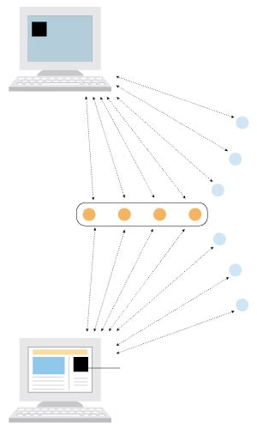
Target advertising
Your PC sends information about previous websites you visited bevore to a third party
The information get used to show you similar or the same product you did not buy on other websites
Companies sell more products because we have more than one opportunity to think about and buy it
Often we buy thinks we don’t need but in the end we think they are usefull

Slide 7
Influencer
Person of the public life
People with a huge range
Share products of companies with their followers
Followers like those people and think: „If they have that spezific product, I have to get it as well because i want to be as cool as they are“
Companies use the influencer to create sympathi for their products/business

Slide 8
The positive site
Easy shopping: we get tons of offers that we need
We don‘t have to search for spezific products because ads show them to us
Personalized ads are more interesting than advertisements that show goods we‘re not interested in

Slide 9
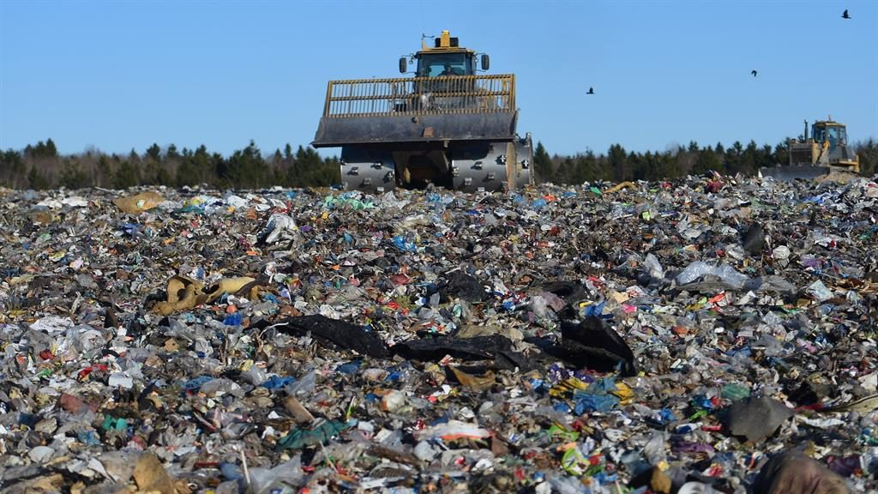
The negative site
Companies have our data and use it for their interests
We buy lots of unnecessary stuff
That leads to overconsumption
That leads to trash, environmental pollution etc.

Slide 10
Quellen
The use of the media: (Stand 30.04.2020)
https://www.owep.de/artikel/40-macht-und-einfluss-medien-in-deutschland
Target advertising: (Stand 25.04.2020)
https://www.washingtonpost.com/apps/g/page/business/how-targeted-advertising-works/412/
Cookies: (Stand 29.04.2020)
https://www.com-magazin.de/praxis/internet/so-funktionieren-cookies-7425.html
What advertisements are doing with us?
https://www.psychologytoday.com/us/blog/ulterior-motives/201008/what-does-advertising-do
Do they listen to our phones? (Stand 25.04.2020)
https://rechtstipp24.de/2017/12/31/handy-hoert-mit-massgeschneiderte-werbung-dank-staendiger-ueberwachung-der-umgebung/
Why are advertisements effective? (Stand 29.04.2020)
http://www.falkrichter.de/psychologie/werbewirkungsmodelle.htm
Influencer: (Stand 30.04.2020)
https://medienkompass.de/was-ist-influencer-marketing/
Bilder :
https://www.washingtonpost.com/apps/g/page/business/how-targeted-advertising-works/412/
https://www.bing.com/images/search?view=detailV2&id=DA85B541EBBAA1532E31166F9DBEB032DCBC595C&thid=OIP.xIT1MUF-3FhPyGpZnDfBtwHaEK&mediaurl=https%3A%2F%2Fs3-eu-west-2.amazonaws.com%2Fmetro-news-s3-prod%2Fwp-content%2Fuploads%2F2018%2F09%2FHeader_1963465_16.9-1024x576.jpg&exph=576&expw=1024&q=landfill+sit&selectedindex=9&ajaxhist=0&vt=0&eim=0,1,3,4,6,8,10

Slide 11
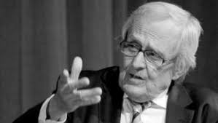
Influence on politics (Joshua Bernhart)
„Politik ist nur der Spielraum, den die Wirtschaft ihm lässt.“
~Dieter Hildebrandt
Grafik 1

Slide 12
Lobbying
Lobbying stands for any attempts to influence the legislators or the government by individuals or private interest groups such as big companys.
The term of lobbying references to the represantatives of the just mentioned interest groups generally waiting in the lobby outside of the legislative chamber.
Besides of influencing politicians lobbying has a few more effects. One of them is that lobbyists inform and brief politicians about their issues which allows them to be well prepared in meetings without wasting time on acribic research.
Therefor in theory politicians can work more effectivly.

Slide 13
Lobbying
Even though mostly disliked and unaccepted by society, germany has huge amounts of lobbyists.
In Berlin alone there are a little over 6000 lobbyists according to Lobbycontrol.
Concerns anually pay millions of euros for it

Slide 14
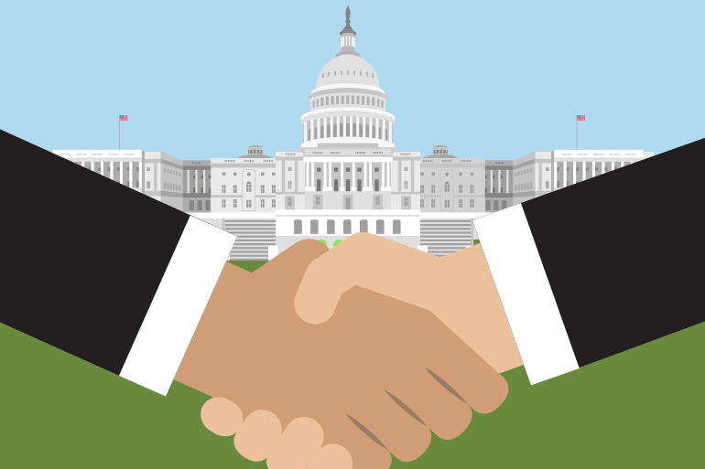
How does lobbying work?
Usually lobbying works much more subtile then we see it in films and TV.
It’s not about buying votes and politicians with a stack of money
It´s more like:
sponsoring election campains
giving the politicians food for thougt in the wished direction
Grafik 2

Slide 15
For example:
1)There is a new law to vote for in the Bundestag about restricting the use of a certain chemical fertiliser that is known for making people sick.
2)The agrar lobby gets active because the law would make it more expensive for theire farmers to produce food.
> idealy they already have someone from there own ranks in the agrar resort ( for example the agrar minister)
> they pay money to foundations and universitys to get some glossed over reports about the chemicals they use

Slide 16
> the reports they now have are used in a combination with grants and bad news about food geting far more exoensive in the futer if the law passes to convince members of parlament to vote against the law
> if all that ain’t enough they will organize protests where thousends of farmers take their biggest traktor to Berlin which usually blocks a lot of traffik and generates publicity for there issue
3) the law gets changed to please the farmers and their needs

Slide 17
Pro´s and Con´s
So as you see lobbying is indeed a mighty weapon when fighting for your political will. Here are some of the reasons one can like or dislike lobbying:
Pro lobbying: | Contra lobbying:
Part of democracy | Money decides how important your vote is
Helps politicians at being more efficient | Provocates political apathy
Protects the requirements for a working economy | Undermines democratic processes
Legal and very professionell | The lower your income the less will you be heared

Slide 18
Quellen:
Lobbyisten in DE (Stand 05.03.2020):
https://www.lobbycontrol.de/2017/10/lobbyismus-in-deutschland-und-europa-die-machtfrage/
https://www.transparency.de/fileadmin/Redaktion/Publikationen/2014/Lobbying_in_Deutschland_TransparencyDeutschland_2014.pdf
Public affairs/ lobbying (Stand 20.04.2020):
https://www.thinkhubbell.com/the-difference-between-public-affairs-and-lobbying/
Vorstellung von Interessensgruppen (Stand 25.04.2020)
http://www.nelson.com/common/polisci/introlobby.html
Pro/ Contra Lobbyismus (Stand 28.04.2020):
https://www.br.de/puls/themen/welt/pro-contra-lobbyismus-100.html

Slide 19
Bildquellen:
Grafik 1:
https://www.google.com/search?q=dieter+hildebrandt&client=firefox-b-d&source=lnms&tbm=isch&sa=X&ved=2ahUKEwj21rrD7Z7pAhWOjqQKHb4_DZoQ_AUoAnoECBgQBA&biw=1366&bih=654#imgrc=6dIF5VrdFyCgyM
Grafik 2:
https://khn.org/news/a-frenzy-of-lobbying-on-21st-century-cures/

